Slide 1
Employee Data Analysis using Excel
STUDENT NAME:S.SRIRANJANI
REGISTER NO:312210067
DEPARTMENT:B.COM GENERAL
COLLEGE:VALLIAMMAL COLLEGE FOR WOMEN

Slide 2
Project Title
EMPLOYEE PERFORMANCE ANALYSIS USING EXCEL

Slide 3


AGENDA
1.Problem Statement
2.Project Overview
3.End Users
4.Our Results and Proposition
5.Dataset Description
6.Modelling Approach
7.Results and Discussion
8.Conclusion
3/21/2024 Annual Review

Slide 4

PROBLEM STATEMENT
To conduct a problem analysis of current employee analytics to identify the key trends, unusual places needing improvement in core situation includes inconsistent performance, potential impact etc. by using Excel Techniques.

Slide 5

PROJECT OVERVIEW
.
The overall project shows three lines to represent the different metrics or performance measures over a set of employees. The x-axis lists employees by their names, ID, gender all these are required for Dataset. The Y-axis appears to show more numerical ranges. And the orange line shows more fluctuations and also green line remains flat, so it represents a baseline or average value.

Slide 6
Who are the end users?
MANAGERS AND TEAM LEADERS: To Evaluate the effectiveness ,productivity and growth of their team members. This helps them make decisions regarding promotion, training needs.
HR professional: To track the employee progress and identify the top performers.
Executive and Senior leadership :They use performance data to understand the overall trends and organizational policies.

Slide 7

OUR SOLUTION AND ITS VALUE PROPOSITION
SORTING- Arrange in the ascending order
FILTERING- adjustments , filling
FORMULAE- EXCEL based
FORMATTING STATUS - highest to lowest
PIVOT CHART - Summarize the employees analysis
GRAPHS - final report

Slide 8
Dataset Description
Employee Dataset – work performance
26 Features
Features – 10
Employee Identity - more than 100000
Gender – male, female
Business units
Numerical – rating or range

Slide 9
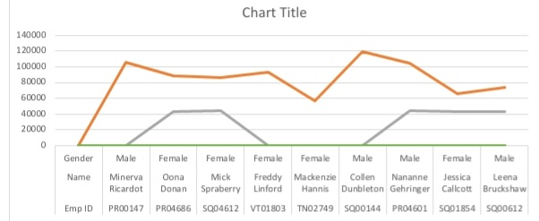

THE "WOW" IN OUR SOLUTION
THE “WOW” IN OUR SOLUTION employees with their Performance Analysis
3/21/2024 Annual Review
9

Slide 10
MODELLING
DATA SET: employee data set
DATA CLEANING: missing value ,irrelevant.
FORMULAE: performance measures, low, medium, high.
PIVOT TABLE AND CHART: business units, summary, gender, employee ID and type.
CHART: bar , histogram , line , pie and pivot CHART.
10

Slide 11
RESULTS
11

Slide 12
conclusion
The Employee Performance Analysis highlights the key strengths, teamwork and communication and job knowledge which positively impact the organizational outcomes.

